Slide 1

Blockchain Technology
Topic:
Prevention of pool-hopping using Smart Contracts - HopStopper
Securing Blockchain Networks with Unwavering Proof Against Pool Hopping
M Ananta Naga Rajesh (1BM21CS098)
Manav Take (1BM21CS102)
Guide:
Namratha M
Assistant Professor
Department of CSE,BMSCE

Slide 2
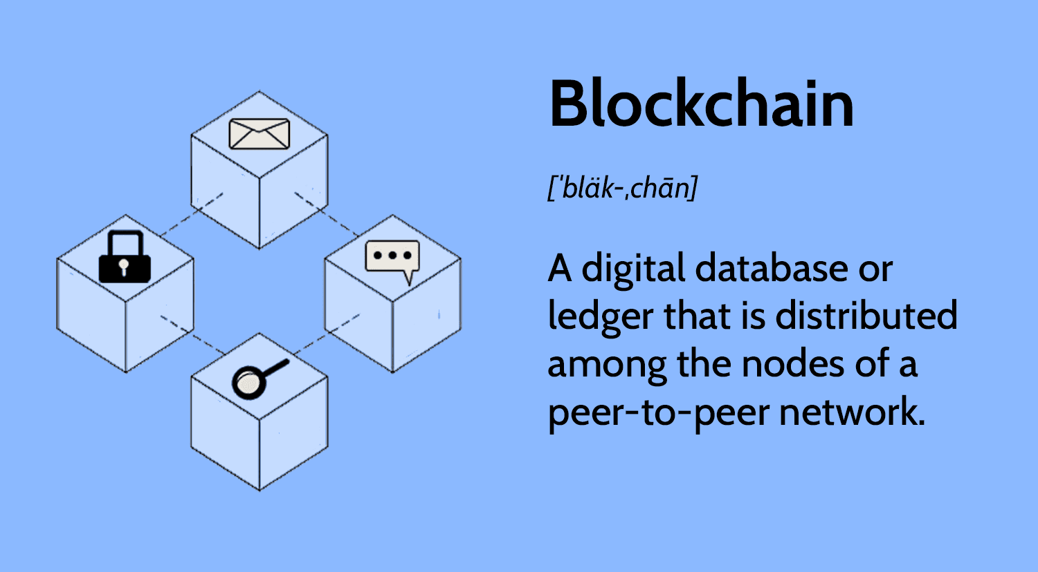
What is a Blockchain?

Slide 3

What is Crypto mining?
Mining is a critical process in blockchain, it involves validating and adding new transactions to the chain. Miners solve complex puzzles to do so.
Solo mining and Pool mining

Slide 4

What is Pool-hopping?
Miners switching between pools to maximize their rewards is called pool-hopping.
This can be harmful to the mining pool as it deprives it of its collective hash power and leaves the block unfit to mine successfully.

Slide 5

Problem Statement
Miners hop from one pool to another to maximize profits
Leads to unfair rewarding
Causes network instability

Slide 6
Existing Solutions
Geometric Method - Fixed fee and variable fee (based on score)
Randomised Consensus - randomly selecting validators
Game Theory Model - a penalty for pool hopping and a reward for long-term commitment to the pool
Adaptive Pool Hopping - monitors sudden changes in hash rate
Stratum Mining - hashing difficulty based on hash rate
Non-Outsourceable Files - can’t outsource the puzzles
Slush’s Method - score, s = exp(T/C)

Slide 7
Drawbacks
Fraudulent miners are not penalised or fined.
No incentives given for honest miners.
Previous history of miner’s actions is not tracked.
Solutions proposed are theoretical and cannot be implemented in real-world.
There is a risk of centralization.
Some are resource intensive and may increase transaction costs.

Slide 8



Proposed Solution - ‘HopStopper’
We came up with a mathematical model which has the following properties
Lower Escrow for honest miners
Impose heavy entry charges for pool hoppers
Keep track of miner’s history via address

Slide 9
Solution Description
The miner will ask the pool management to connect to the network
Pool Manager verifies miner certification
Assess the risk of miner by checking their certificates through miner address
Escrow is calculated using the formula and requested from miner as a deposit to enter the pool

Slide 10
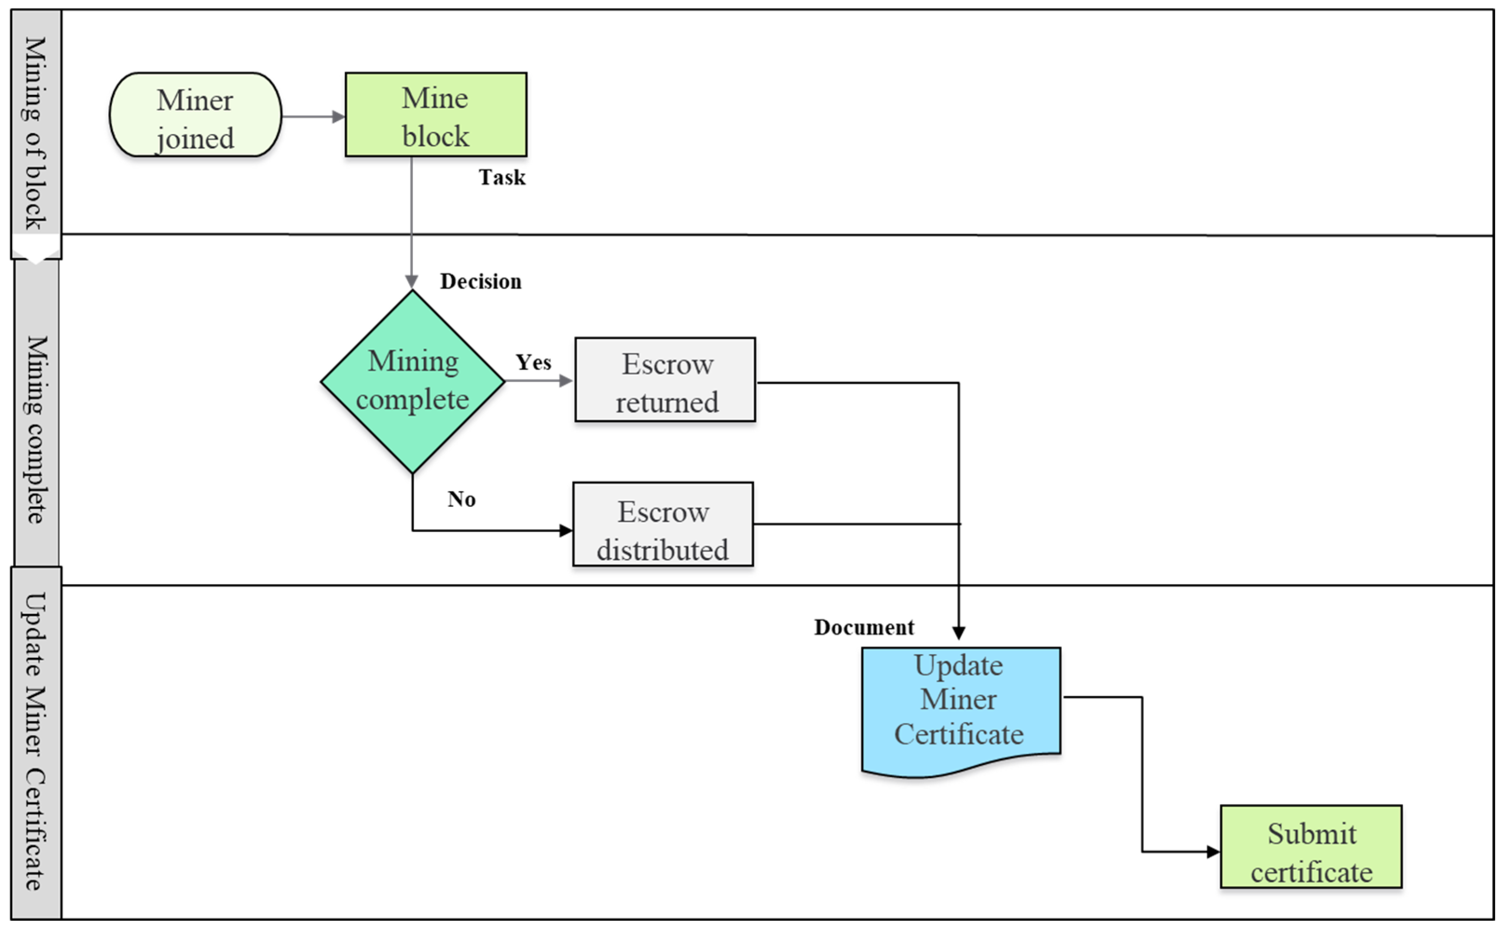

Slide 11
Mathematical Model
M = 1 - e^(-k(α + μ))
where, α - number of pool hops
μ - number of SC violated
k - constant
D = Min. Deposit + M _{risk} * (Max. Deposit)
risk

Slide 12
Gain in Technical Knowledge
Understanding of Blockchain technology and its potential for enhanced security, transparency, and decentralization in modern systems.
Development of mathematical formulas and models to address specific challenges in the field of Blockchain.
Research skills, including the ability to gather, analyze, and synthesize information from various sources.
Collaboration and teamwork, interpersonal communication skills, critical thinking and problem solving skills.

Slide 13
Roles and Responsibilities
Gathering the information (Manav)
Writing of the research paper (Rajesh)
Co - ordinating with the guide(Rajesh)
Development of mathematical model (Manav)
Testing the mathematical model (Rajesh)

Slide 14
References
Kiayias, A., Panagiotakos, G., & Tsiopoulos, L. (2018). Pool-Hopping in Proof-of-Stake Cryptocurrencies. In International Conference on Financial Cryptography and Data Security (pp. 20-35). Springer.
Delgado-Segura, S., Pérez-Solà, C., & Herrera-Joancomartí, J. (2018). Game-Theoretic Analysis of Pool Hopping in Proof-of-Stake Blockchain Systems. IEEE Transactions on Information Forensics and Security, 13(9), 2329-2340.
Nayak, K., Kumar, A., & Miller, A. (2016). Pool-Hopping Attacks in Proof-of-Work Mining Pools. In Proceedings of the 2016 ACM SIGSAC Conference on Computer and Communications Security (pp. 204-215). ACM.
Kim, D. H., & Lee, H. K. (2016). Mitigating Pool Hopping in Multi-Pool Mining. Journal of Information Processing Systems, 12(2), 189-200.
Sapirshtein, A., Sompolinsky, Y., & Zohar, A. (2016). Pool-Hopping and Block-Withholding in Bitcoin Mining. In International Conference on Financial Cryptography and Data Security (pp. 203-221). Springer.
Singh, Sushil Kumar, Mikail Mohammed Salim, Minjeong Cho, Jeonghun Cha, Yi Pan, and Jong Hyuk Park. 2019. "Smart Contract-Based Pool Hopping Attack Prevention for Blockchain Networks" Symmetry 11, no. 7: 941. https://doi.org/10.3390/sym11070941
Eugenio Cortesi , Francesco Bruschi , Stefano Secci , Sami Taktak .“A new approach for Bitcoin pool-hopping detection” Received 29 May 2021, Revised 6 December 2021, Accepted 27 December 2021, Available online 14 January 2022, Version of Record 19 January 2022.

Slide 15
THANK YOU

